Slide 1
TEAM - traCOVID
Problem Statement -
CORONA SYMPTOM TRACKING AND ESCALATION

Slide 2
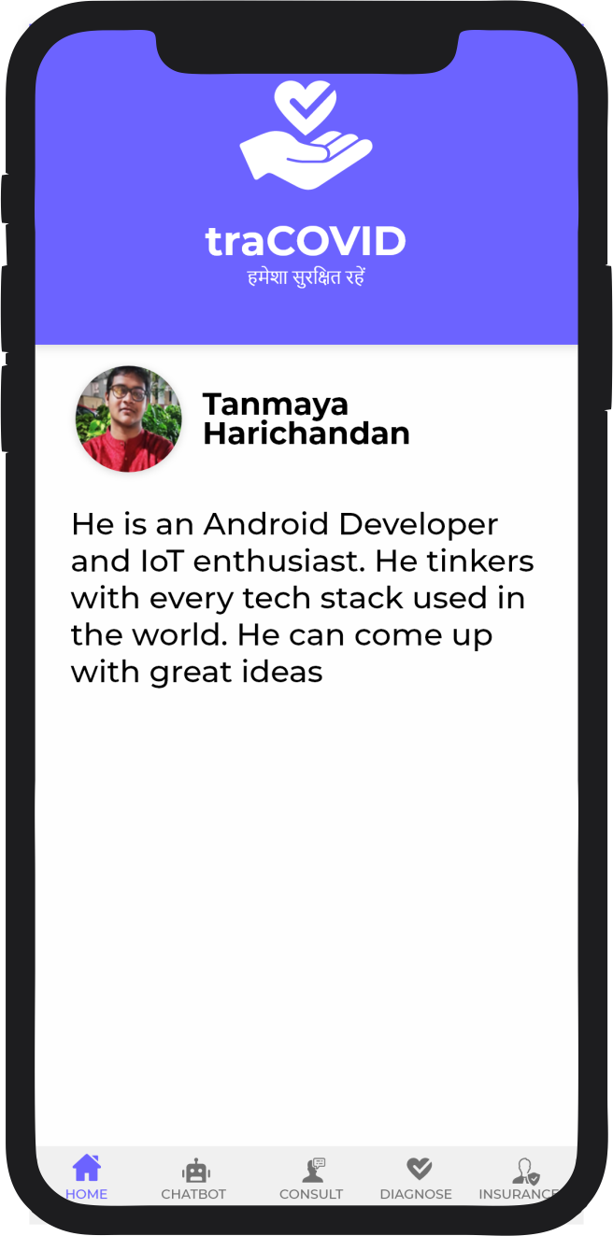
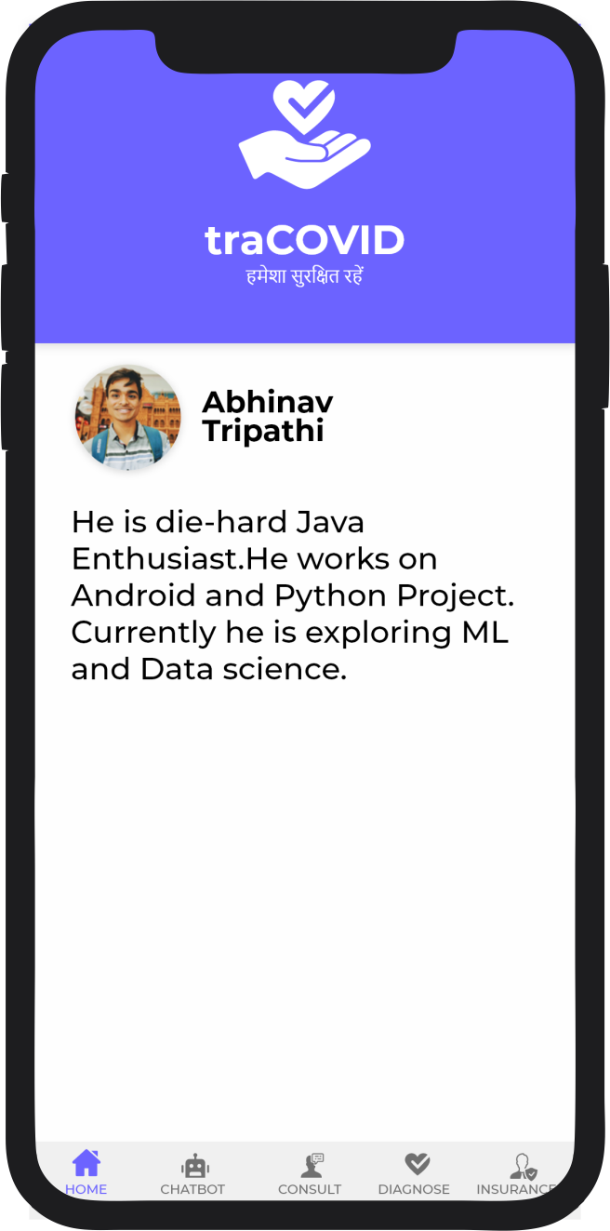
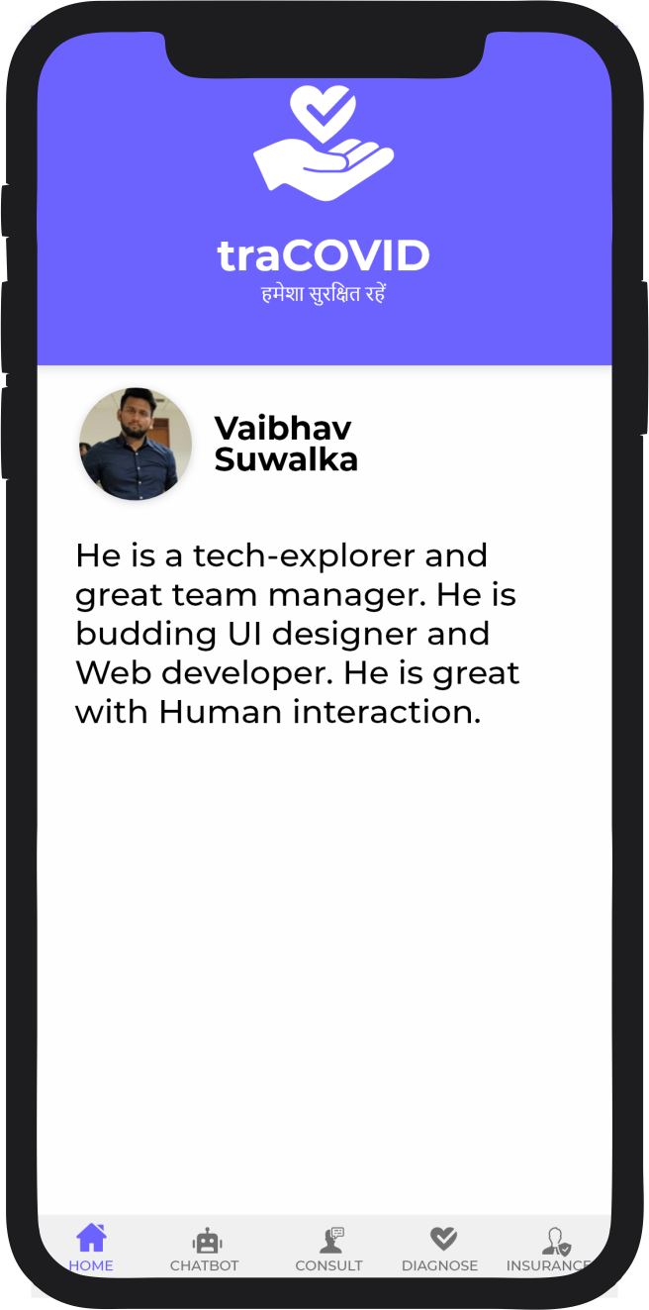
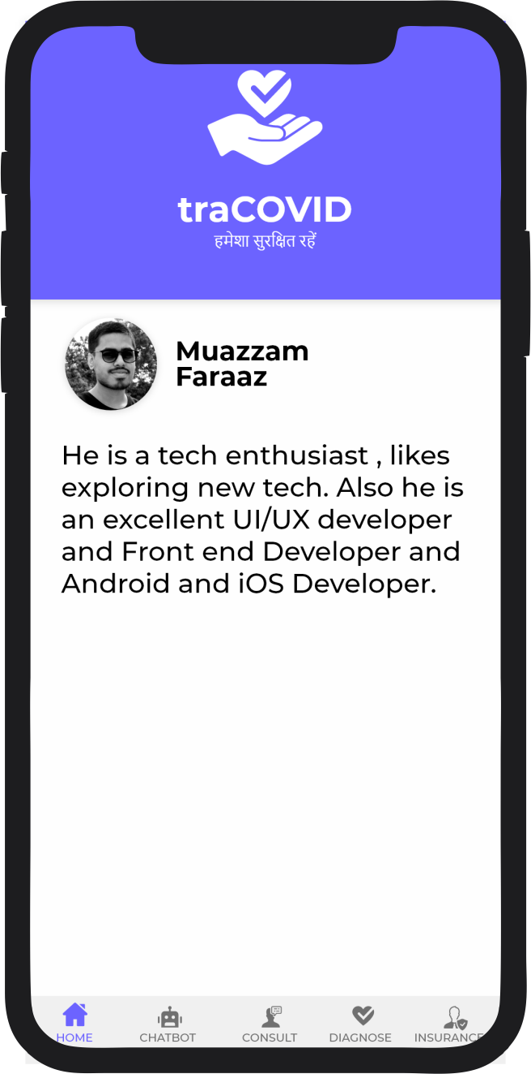


MEET THE TEAM

Slide 3
OUR SOLUTION
An APP that could help suspected patients to get in touch with doctor and have regular check on symptoms.

Slide 4
Our process is easy
Daily symptoms check
Self Assessment Chatbot
Book Appointment for testing
In our app you can input daily record of symptoms you felt.
You can chat with the bot. that could help could help you deal with simple issues
If the symptoms are found to be similar, you can book a appointment for testing
1
2
3

Slide 5
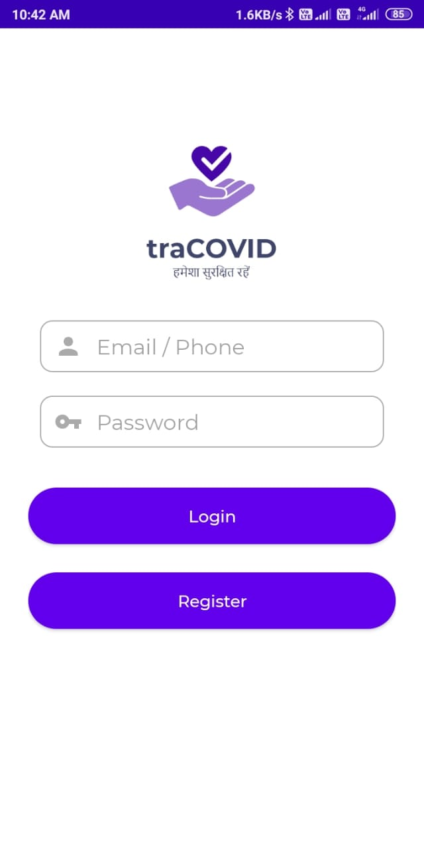
LOGIN Page

Slide 6
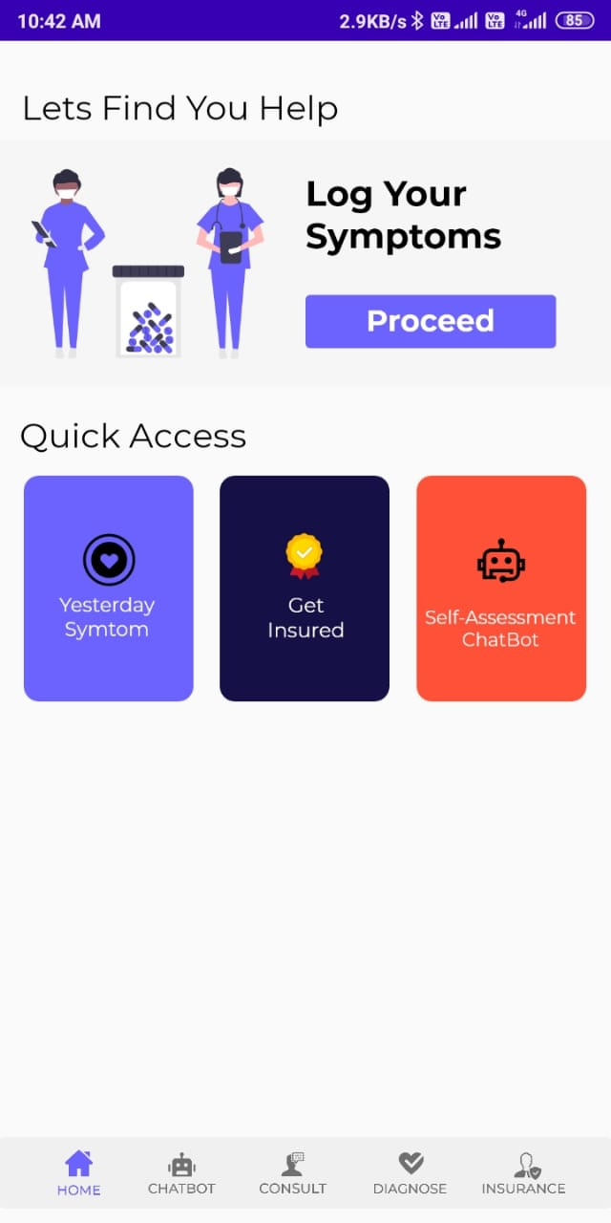
Dashboard

Slide 7
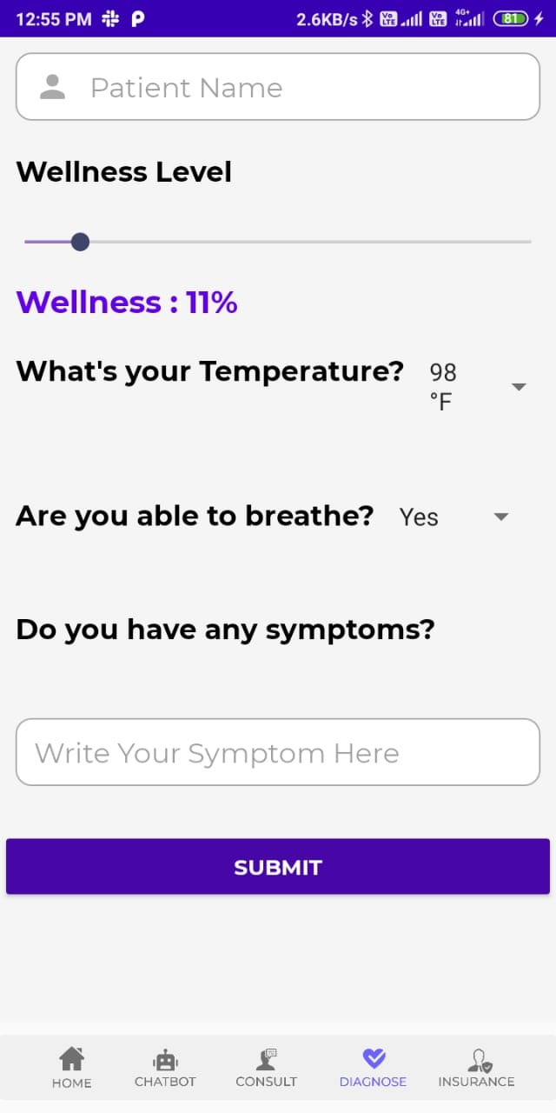
Wellness Checker

Slide 8
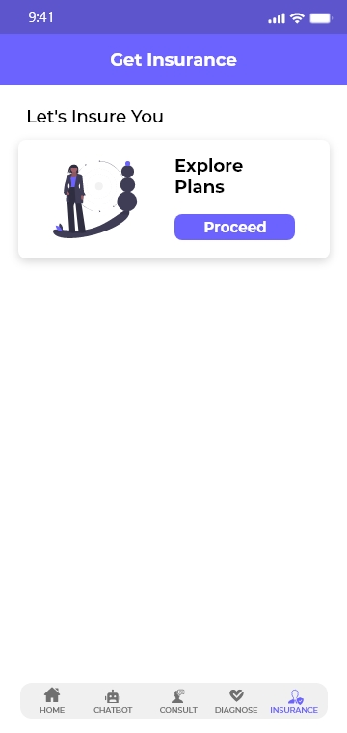
Insurance

Slide 9
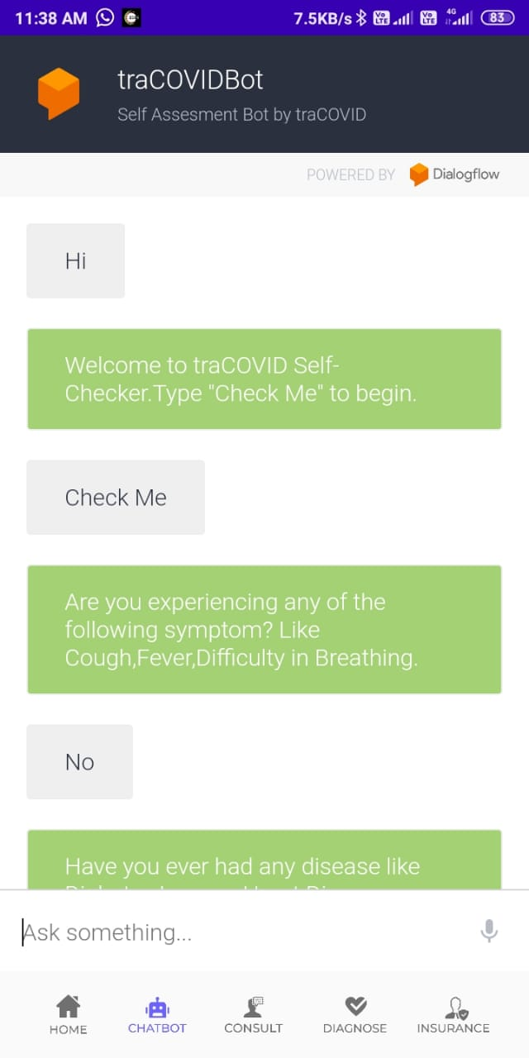
Chatbot

Slide 10
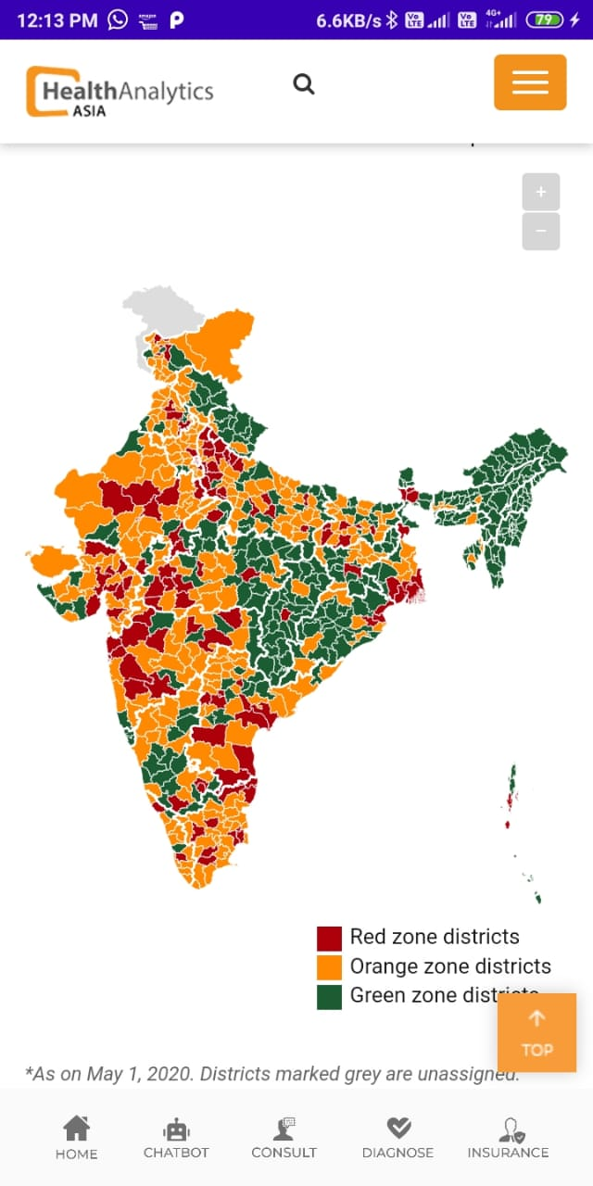
Covid Tracker map source - https://www.ha-asia.com/mapping-covid-19-hotspots-in-india/

Slide 11
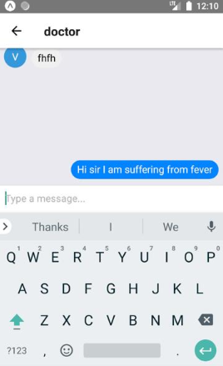
Chat App

Slide 12




Tech Stack
Frontend – React(Progressive Web App), JS, HTML, CSS, Sass etc or Java , XML(Native App)
Server - Node.js ,Express, hosted on Heroku or Firebase
Database - MongoDB, Firebase(NoSQL) API- Node.JS, ReSTful API, or Firebase API
Cloud - Google Cloud, IBM or AWS.
ML and Chatbot - Google Diagflow or IBM Watson

Slide 13
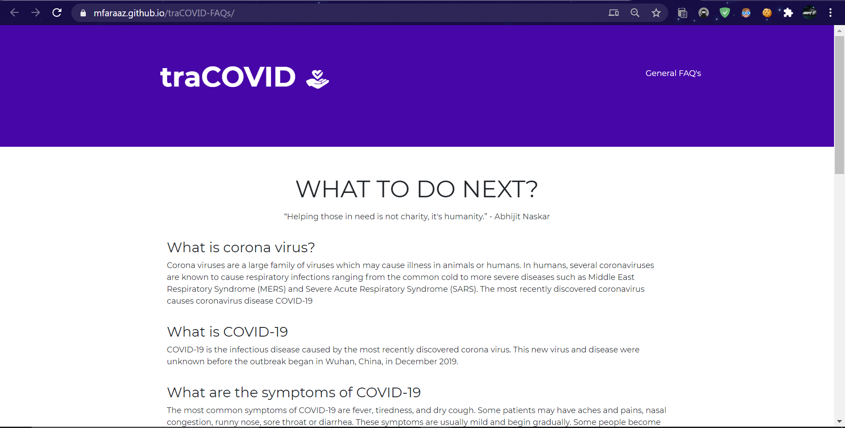
Our Website http://bit.ly/traCOVID
Place your screenshot here

Slide 14
Thanks!
Any questions?

